Slide 1

Fake News Detector
Submitted Under the Supervision of Dr. Sumit Hazra
BY :
Aniket Ojha
Ratan Pandith
Ruthwik P.V.N

Slide 2

Problem Statement :
Why Detect Fake News ?
The rise of social media has significantly increased the ease with which misinformation spreads across platforms. Fake news has a powerful impact—it can sway public opinion, influence election outcomes, and even affect critical health decisions, as seen during the COVID-19 pandemic. Traditional methods of fact-checking are often slow, manual, and incapable of keeping up with the vast amount of information shared online every second. This creates an urgent need for an automated system that can detect and flag fake news in real-time.
For example, a widely circulated but false claim during COVID-19 was that “drinking hot water kills coronavirus,” which misled many before being debunked.

Slide 3

Objective & Tools :
Objectives :
Tools & Tech Stack :
Classify news articles as real or fake using machine learning.
Use natural language processing (NLP) to understand the news text.
Build a reliable and fast system for detecting fake content.
Programming: Python
Libraries: Pandas, Numpy, Scikit-learn, NLTK, TF-IDF
IDE: Jupyter Notebook / VS Code
Dataset: Kaggle Fake News Dataset
📌 (Add dataset source: https://www.kaggle.com/clmentbisaillon/fake-and-real-news-dataset)

Slide 4
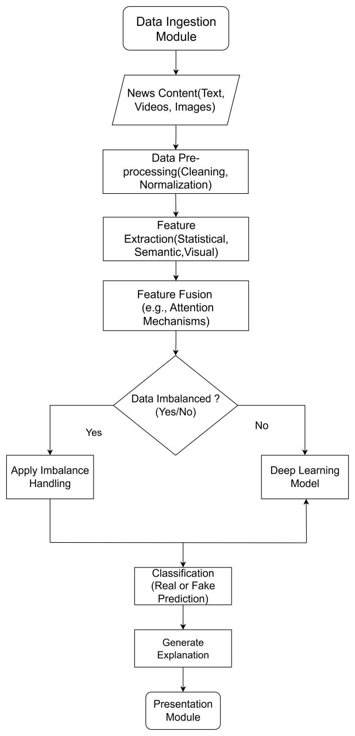
How It Works – Methodology :

Slide 5
Future Scope & Conclusion Future Scope:
Future Scope :
Conclusion :
Use deep learning (LSTM/Transformers) for better accuracy.
Detect fake videos and images using multimodal AI.
Integrate with browser extensions or fact-checking tools.
Fake news detection is a crucial step toward digital truth.
ML + NLP provide powerful tools to combat misinformation.
This project gives a practical solution to a growing problem.

Slide 6

Wake up to reality.
In this synthetic world, the weak survive on AI
I conquer with it - I’m not the player. I’m the algorithm.

